Slide 1


Homework Code: J3

Slide 2
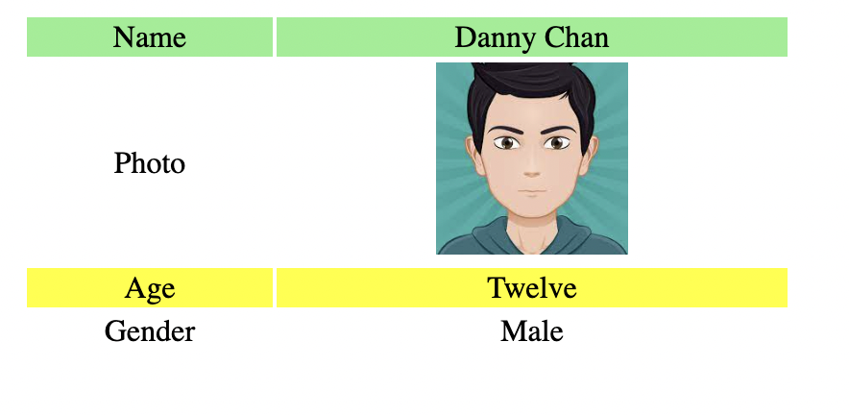
J3H1.html
Create the page as below. Then, change the file name to index.html.
Put the file in Github. Then, deploy the file in render. Com. Upload your link to the LMS.
You can learn how to create github and render.com by studying the video clip. CLICK

Slide 3
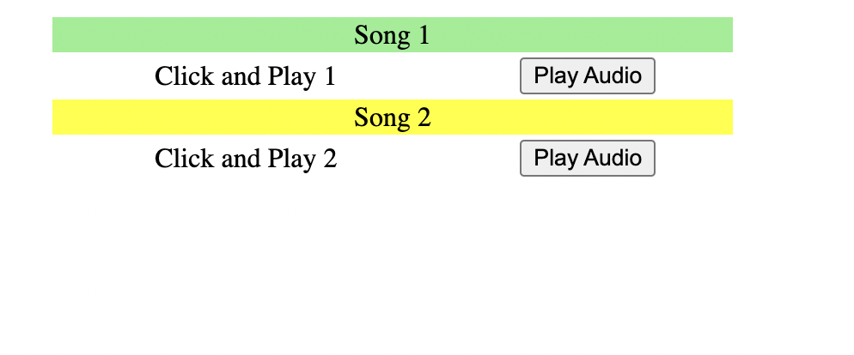
J2H2.html
Add the two songs onto Github. Click and play the songs. Create the page as below. Then, change the file name to index.html.
Put the file in Github. Then, deploy the file in render. com

Slide 4
THANK YOU

